Slide 1
Software Engineering Design
Week11 HW, Team4 李諺傑 葉芯蘊 李冠儀 許景淯 陳垣豪

Slide 2
9-1

Slide 3
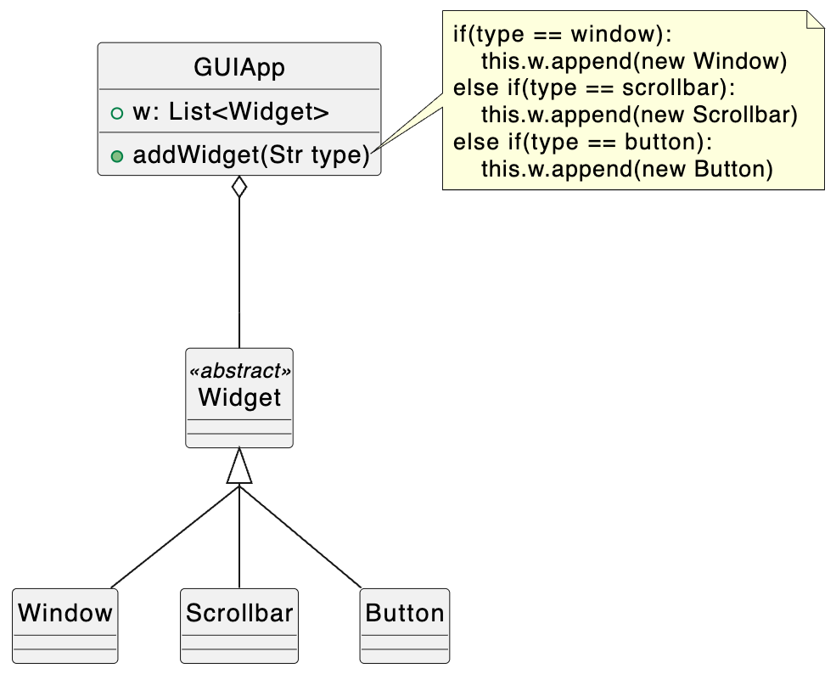
Homework 9-1 Initial Design - 1

Slide 4
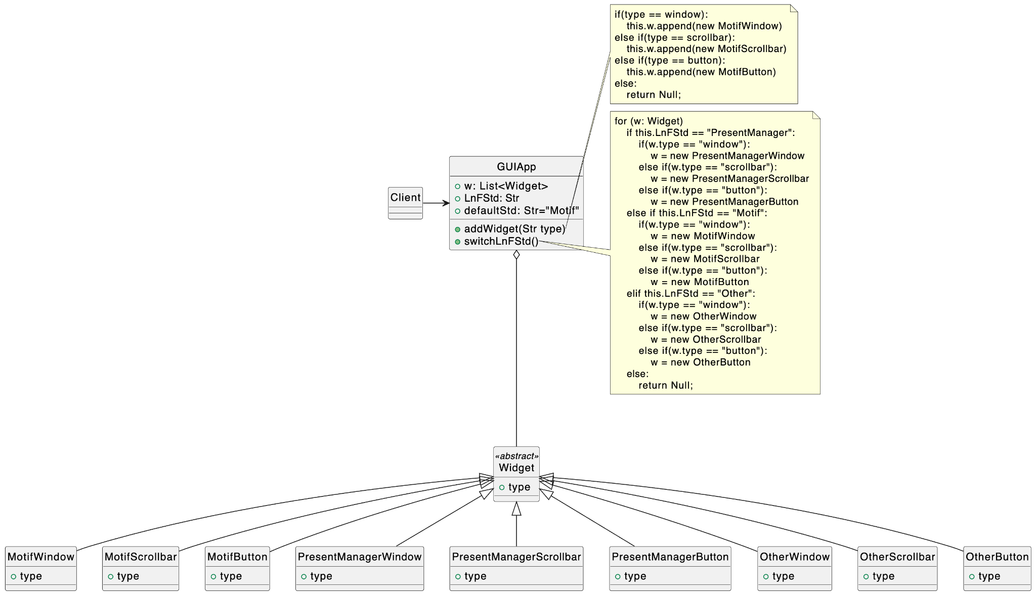
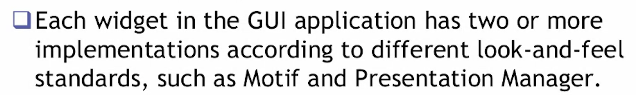
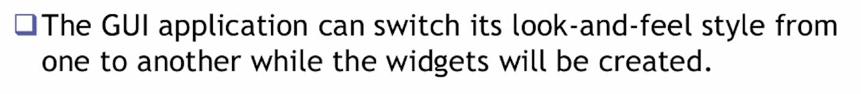
Homework 9-1 Initial Design - 2

Slide 5
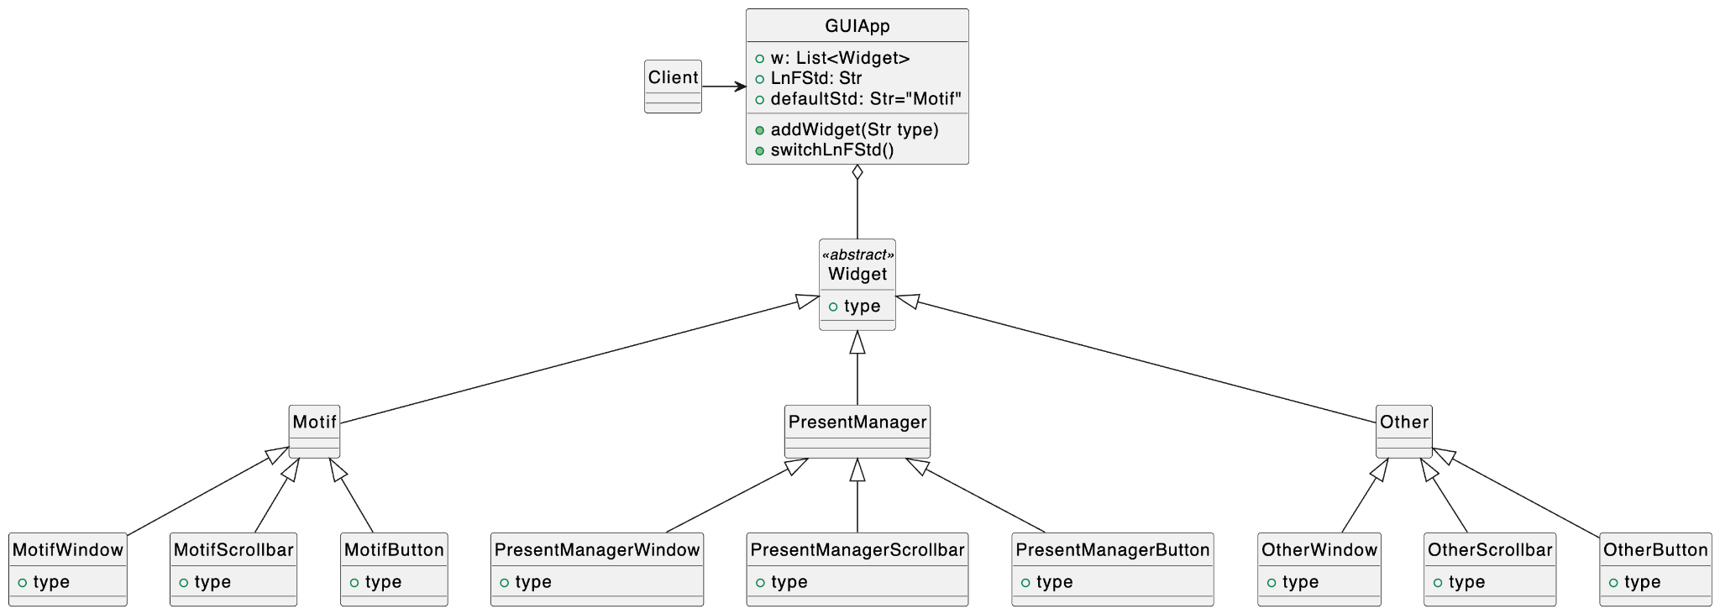
Homework 9-1 Refactor 1 - Encapsulate

Slide 6
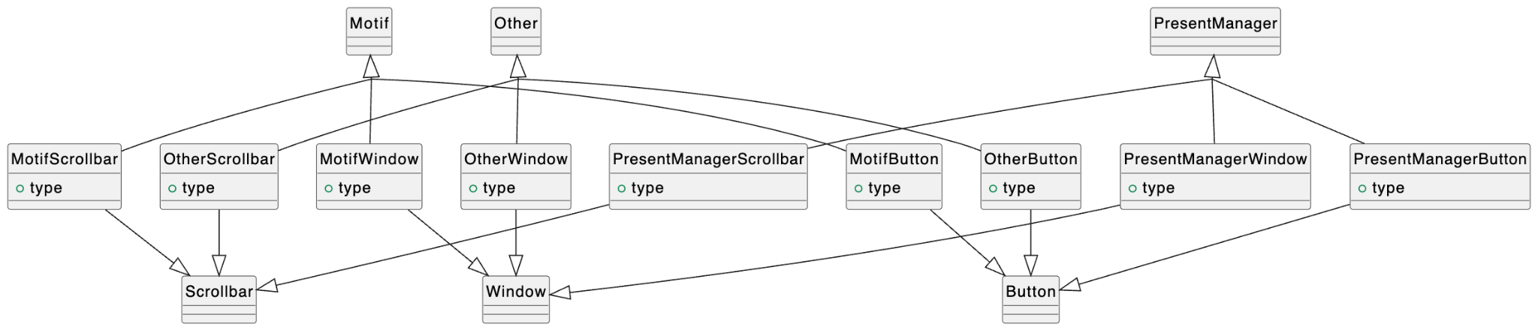
Homework 9-1 Refactor - Abstraction
Abstract factory?

Slide 7
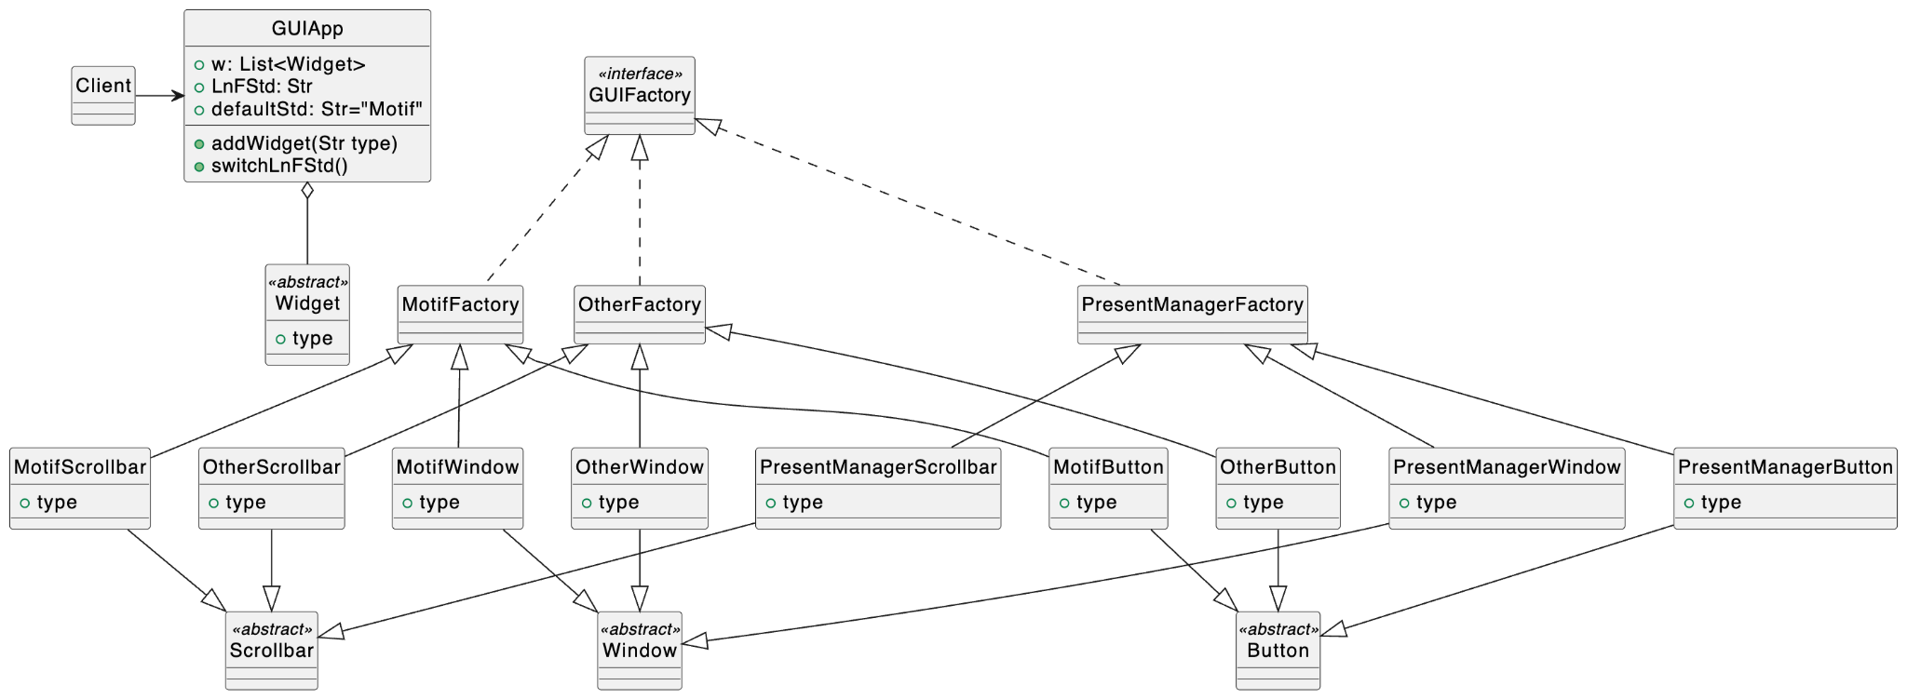
Homework 9-1 Refactor - Abstraction

Slide 8
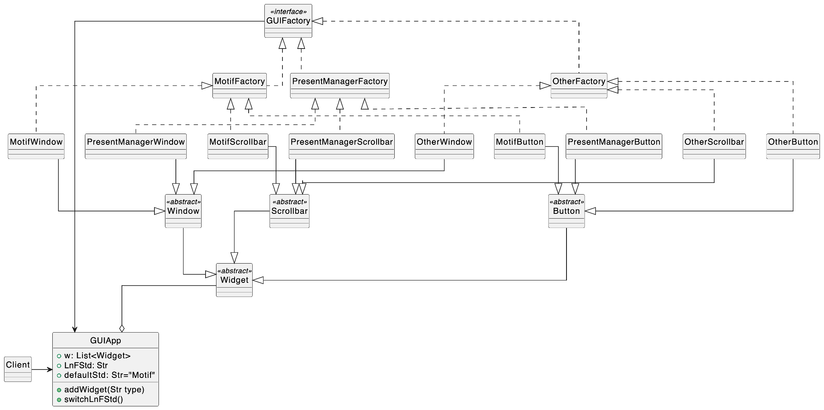
Homework 9-1 Refactor - Delegation

Slide 9
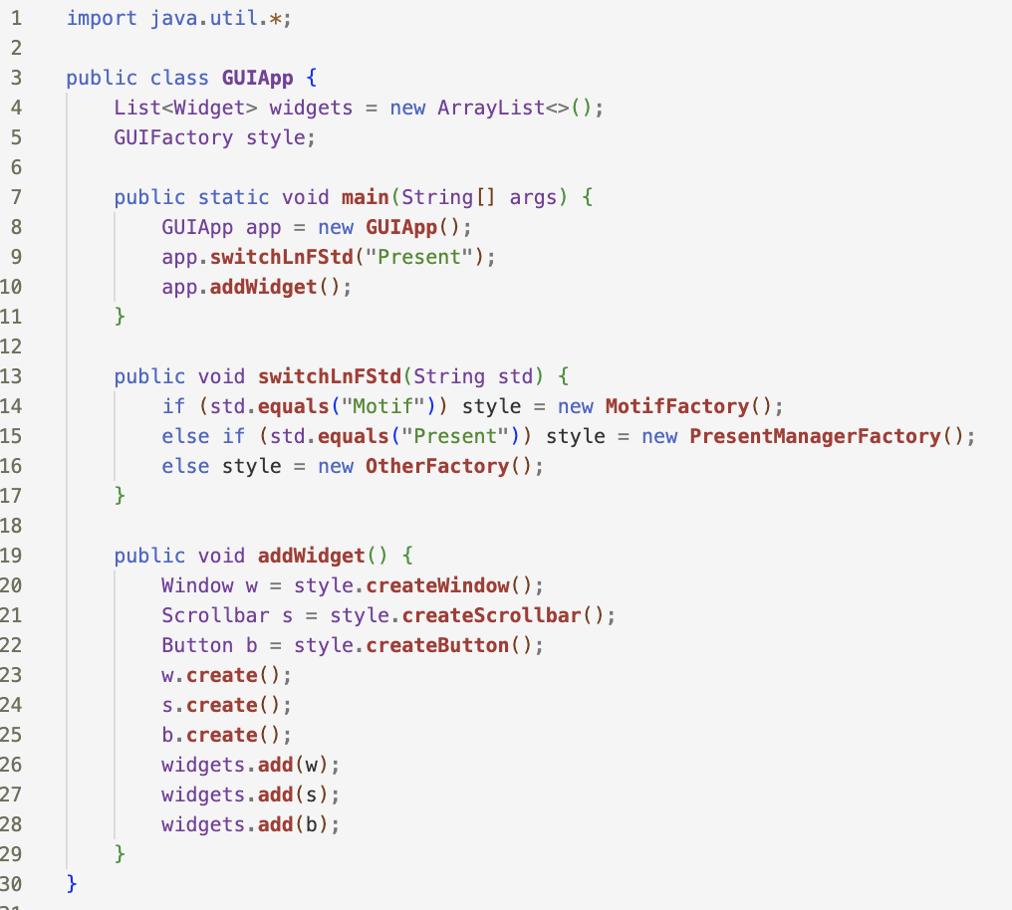
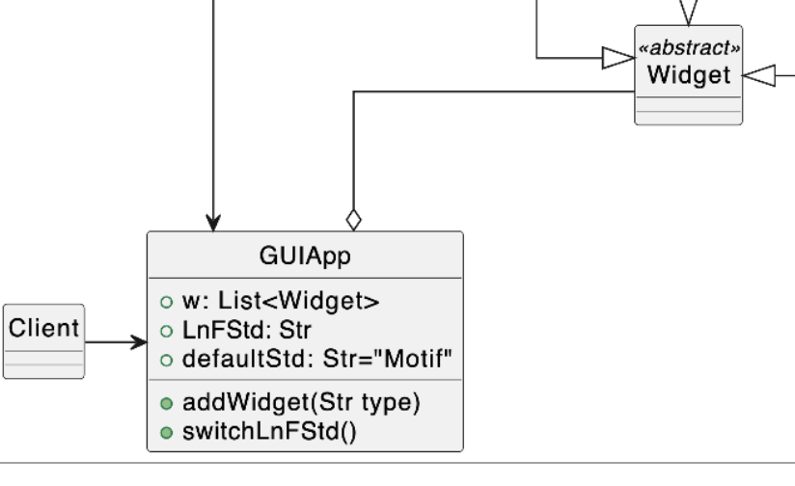
Homework 9-1 GUIApp and Widgets

Slide 10
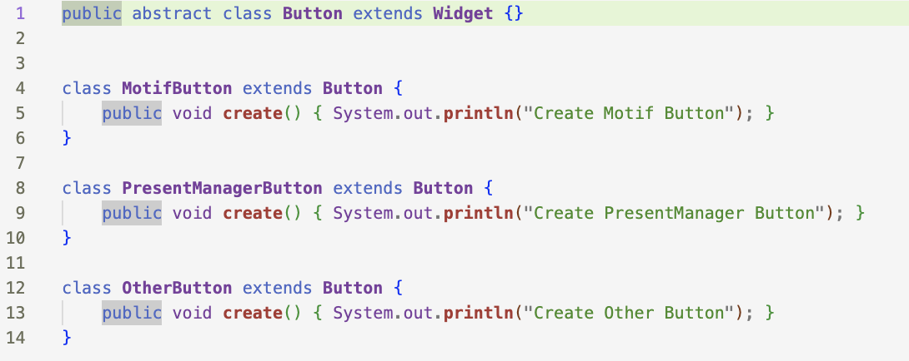
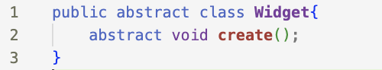
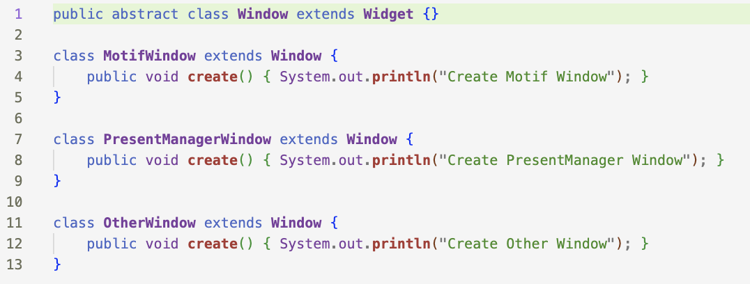
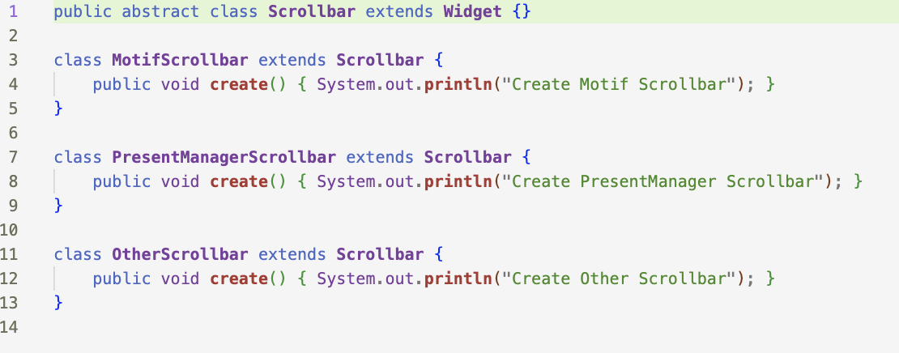
Homework 9-1 GUIApp and Widgets

Slide 11
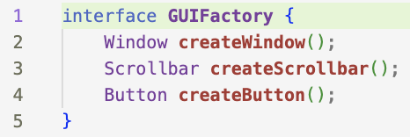
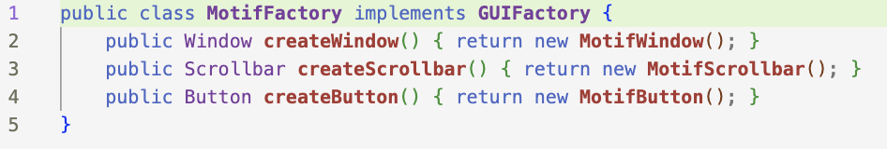
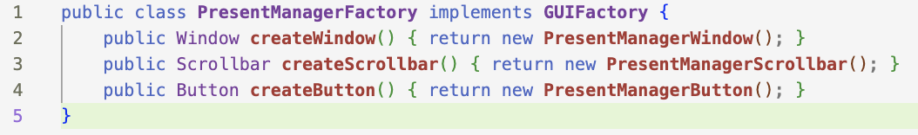
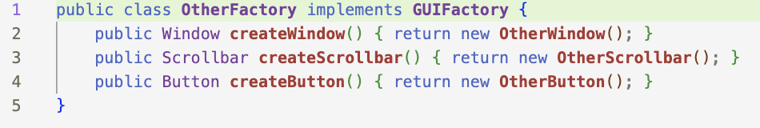
Homework 9-1 GUIFactory and LnFStds

Slide 12
9-2

Slide 13
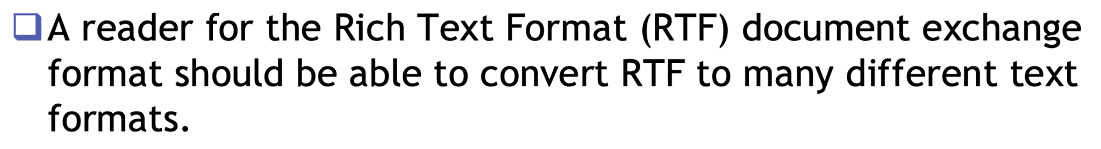
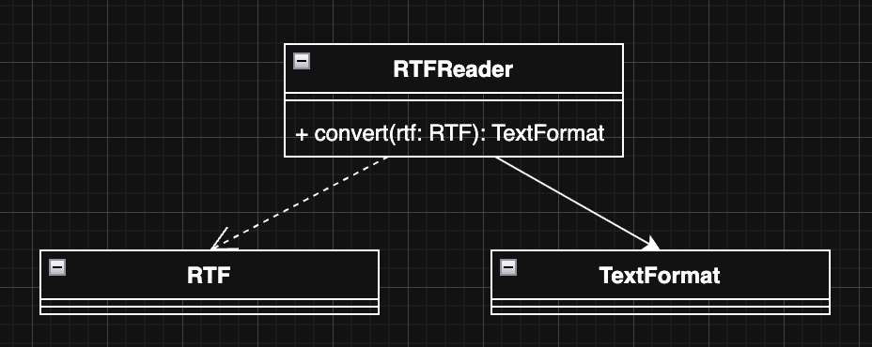
Initial Design (1/2)

Slide 14
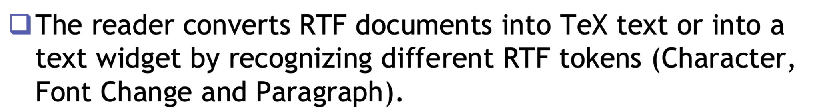
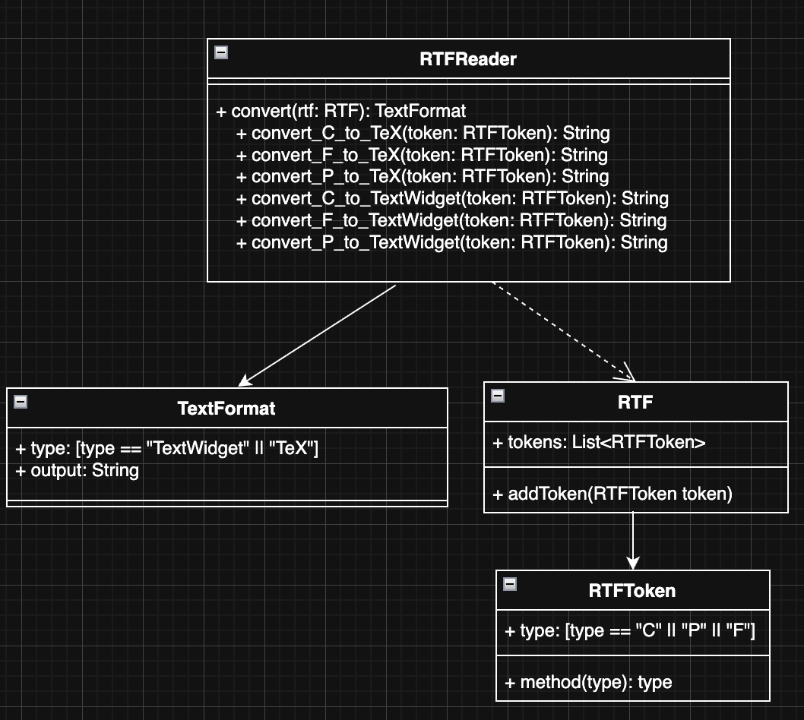
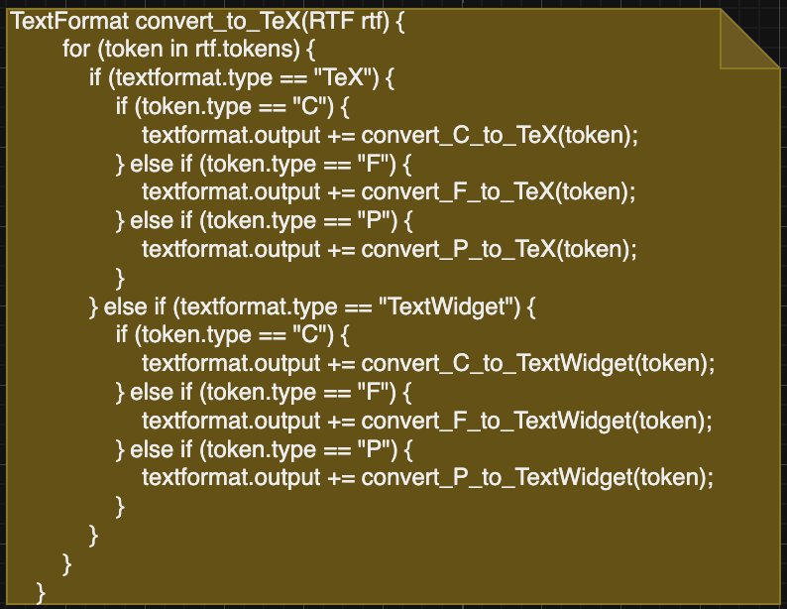
Initial Design (2/2)

Slide 15
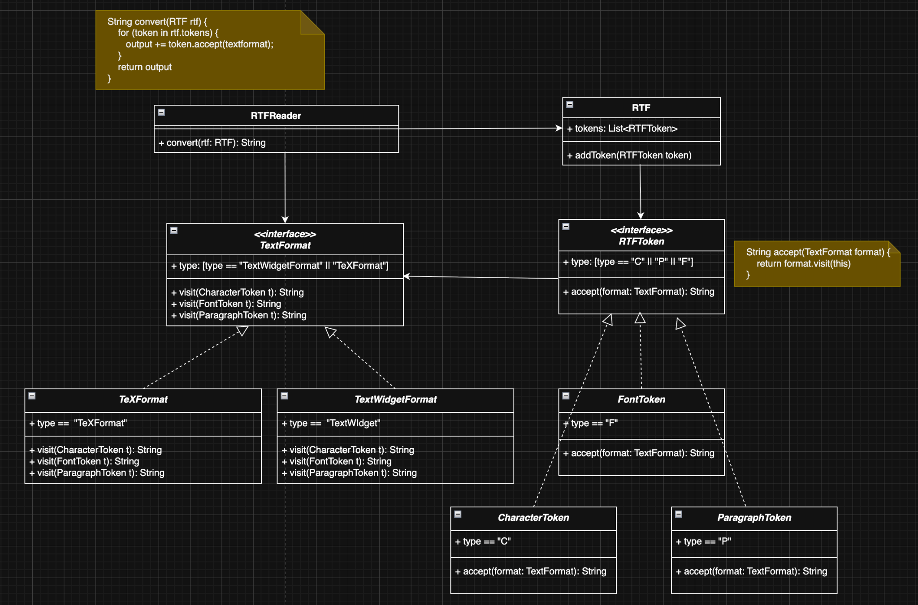
Refactor
Encap: TeXFormat / TextWidget || FontToken / CharacterToken / ParagraphToken
Abstraction: RTFToken / TextFormat
Delagate: RTFReader.convert() -> RTFToken.accept() -> TextFormat.visit()
(double dispatch)

Slide 16
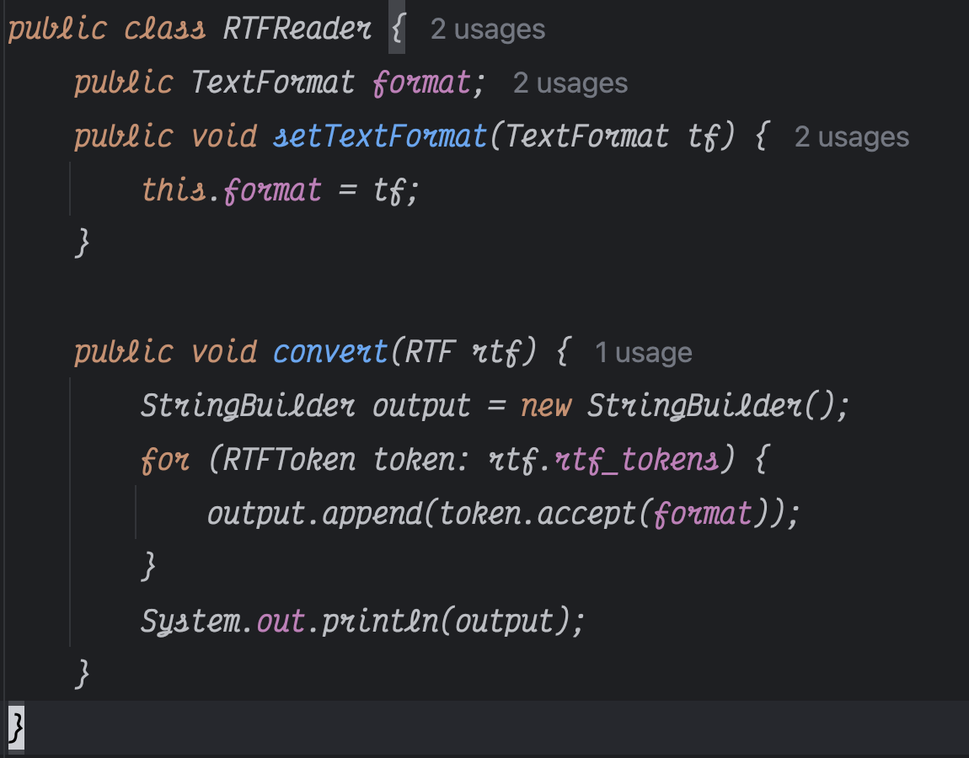
Code (1/3) - RTFReader

Slide 17
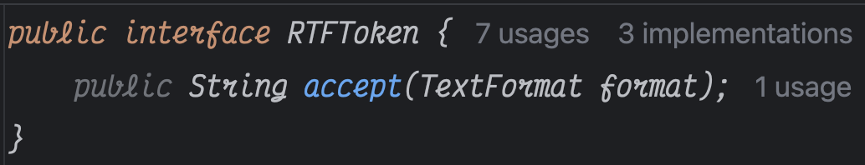
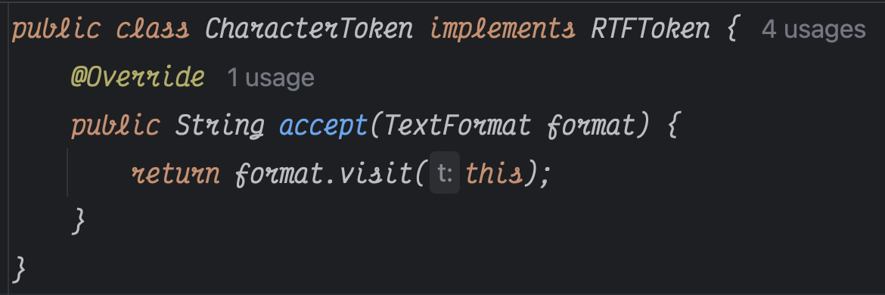
Code (2/3) - Token

Slide 18
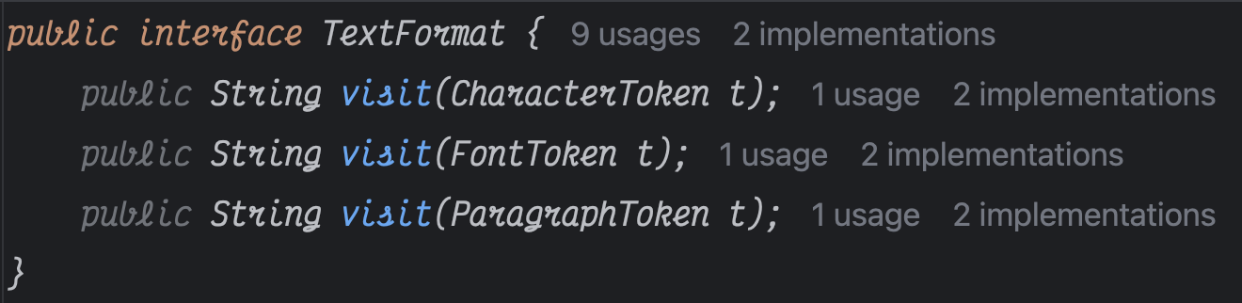
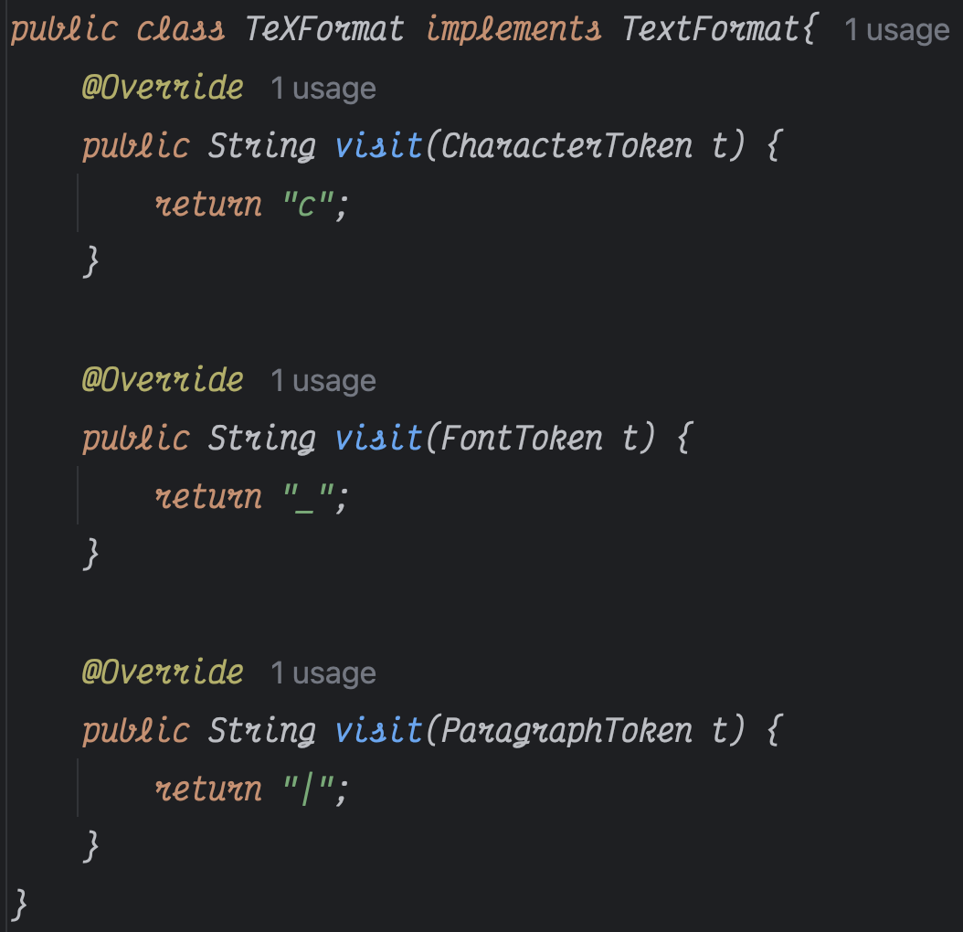
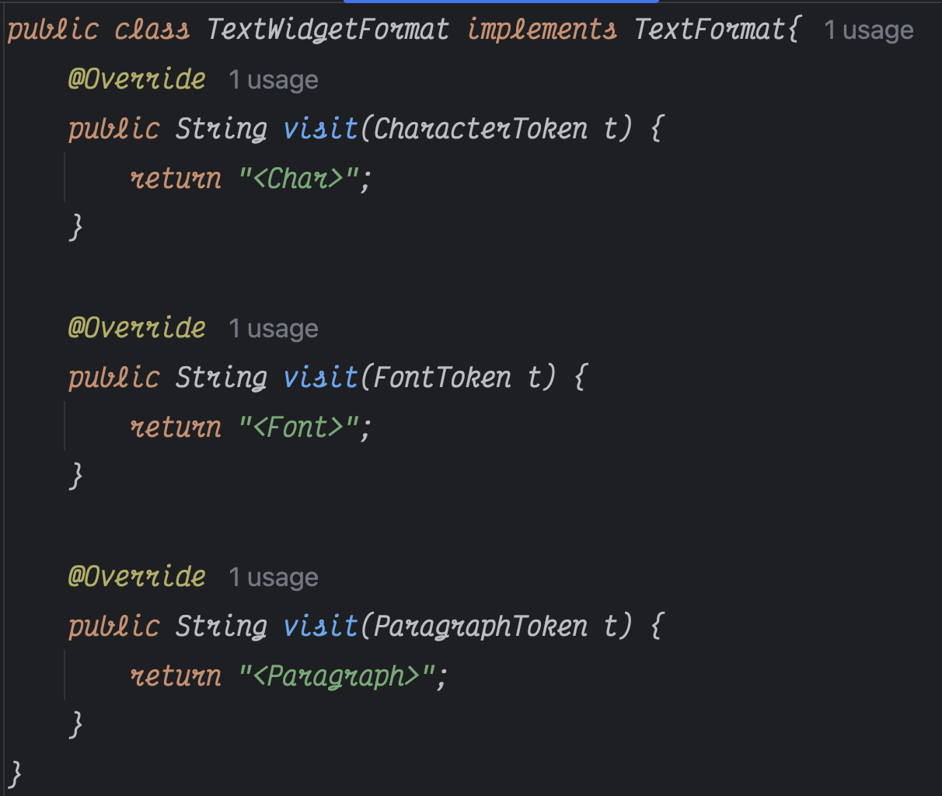
Code (3/3) - TextFormat

Slide 19
9-3

Slide 20
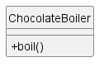
Initial Design 1

Slide 21
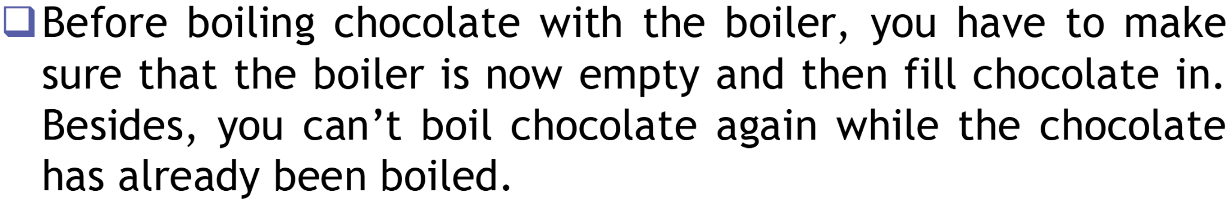
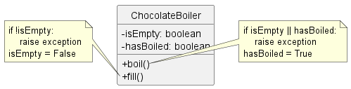
Initial Design 2

Slide 22
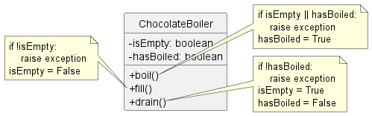
Initial Design 3

Slide 23
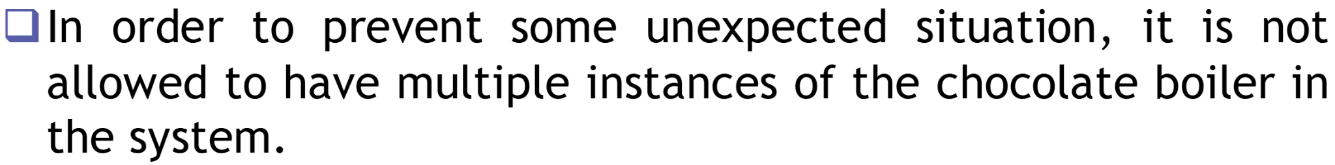
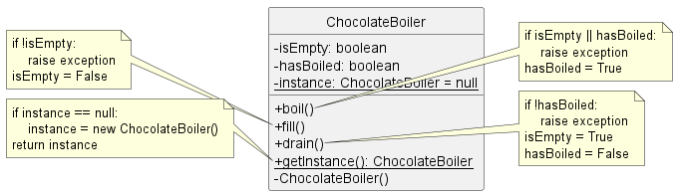
Initial Design 4

Slide 24
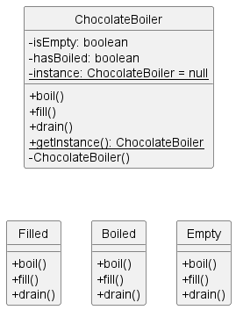
Refactor 1: Encapsulate

Slide 25
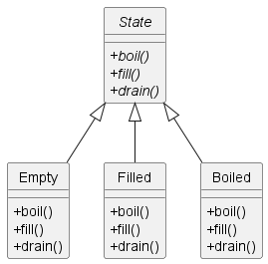
Refactor 2: Abstract

Slide 26
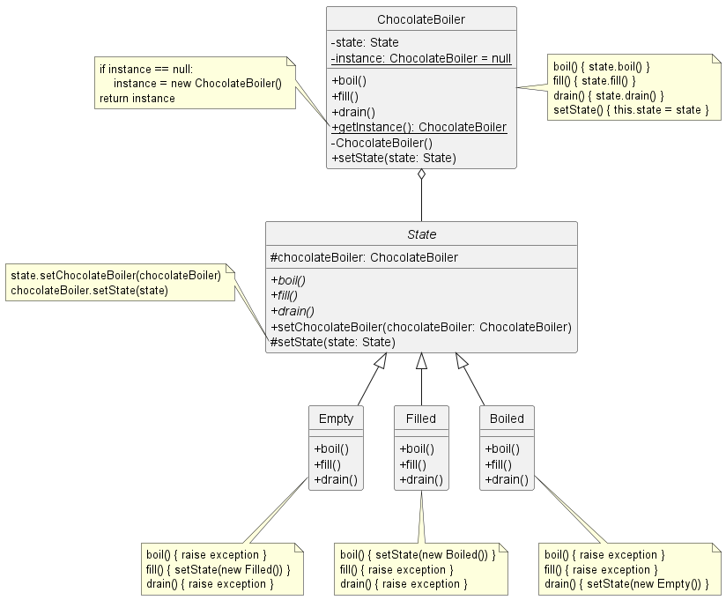
Refactor 3: Compose

Slide 27
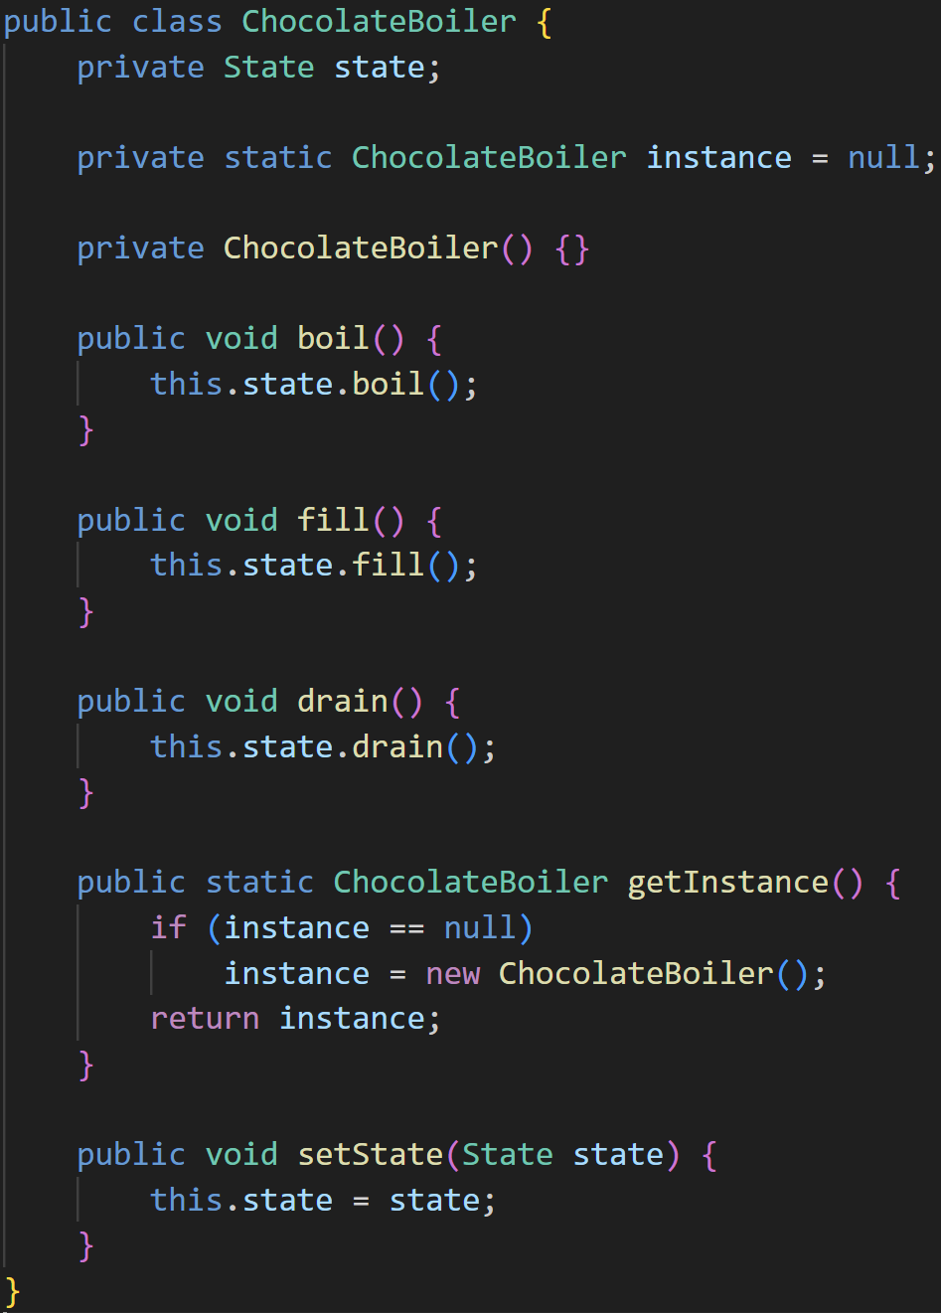
Code: ChocolateBoiler

Slide 28
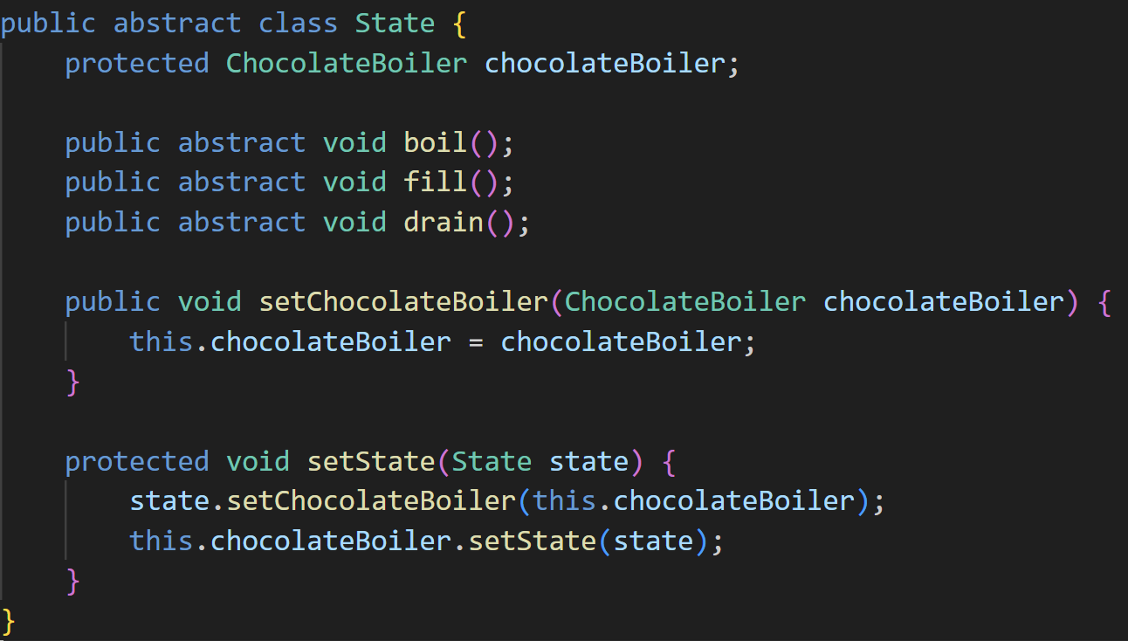
Code: State

Slide 29
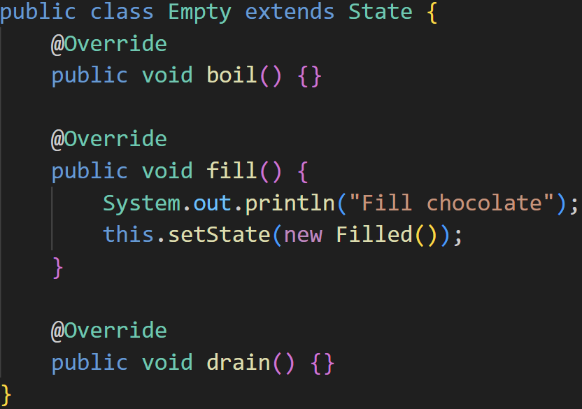
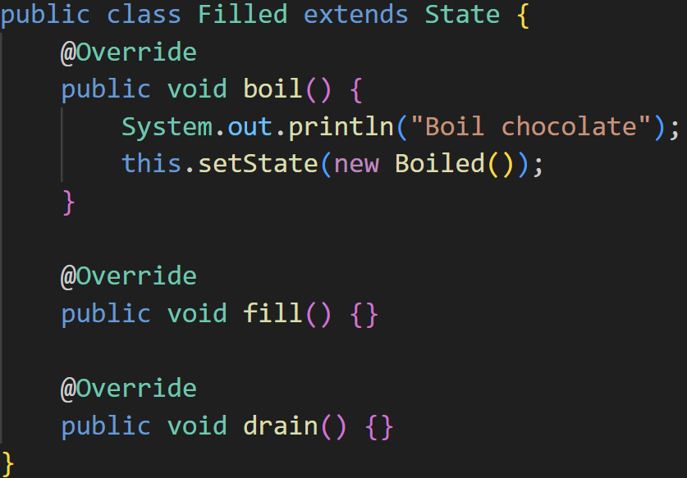
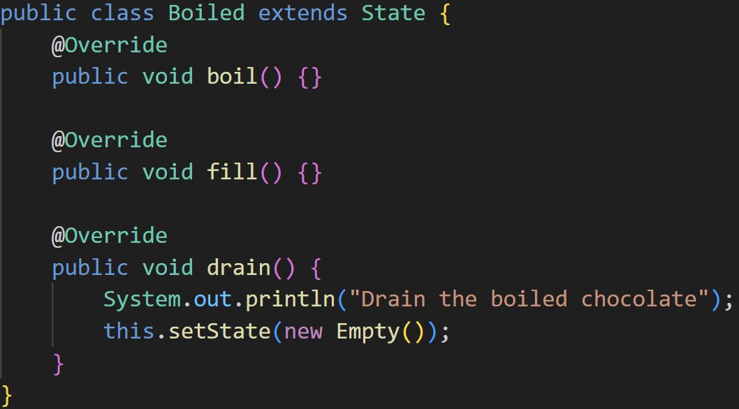
Code: Concrete States

Slide 30
WBS TraceCode進度

Slide 31
李諺傑
本週：
framework.JdkDynamicAopProxy.java
ObjenesisCglibAopProxy.java
CglibAopProxy.java
整理framework中的class diagram
duration: 2, trace code: 833 行)
累積：833 LoC

Slide 32
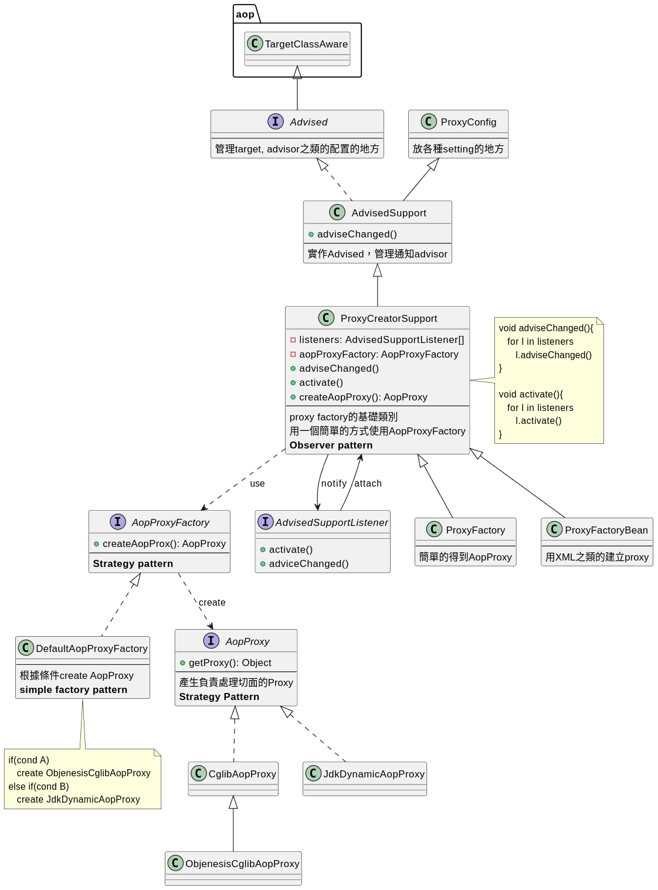
李諺傑
client

Slide 33
李諺傑 - Observer Pattern

Slide 34
李諺傑 - Strategy Pattern(1)

Slide 35
李諺傑 - Simple Factory Pattern

Slide 36
李諺傑 - Strategy Pattern(2)

Slide 37
葉芯蘊
本週：
config.(BeanExpressionResolver, BeanFactoryPostProcessor, BeanPostProcessor) (duration: 1, trace code: 23 行)
累積：1584 LoC

Slide 38
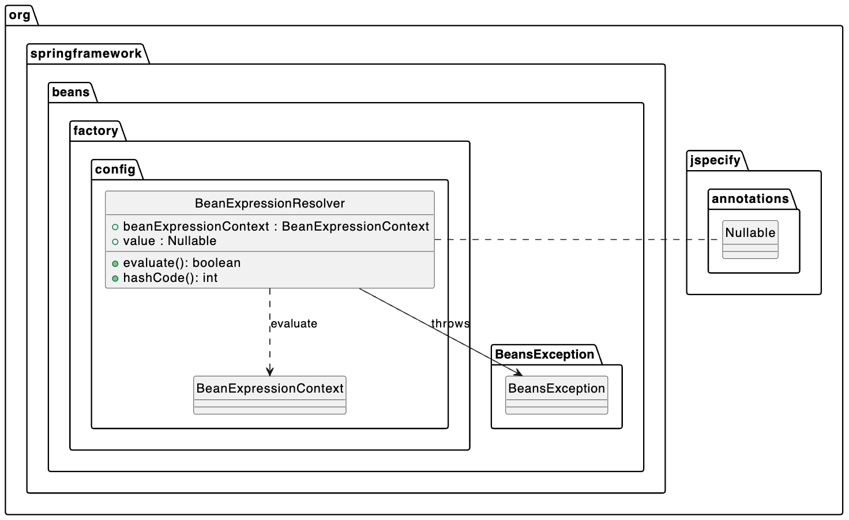
葉芯蘊：Config (BeanExpressionResolver)

Slide 39
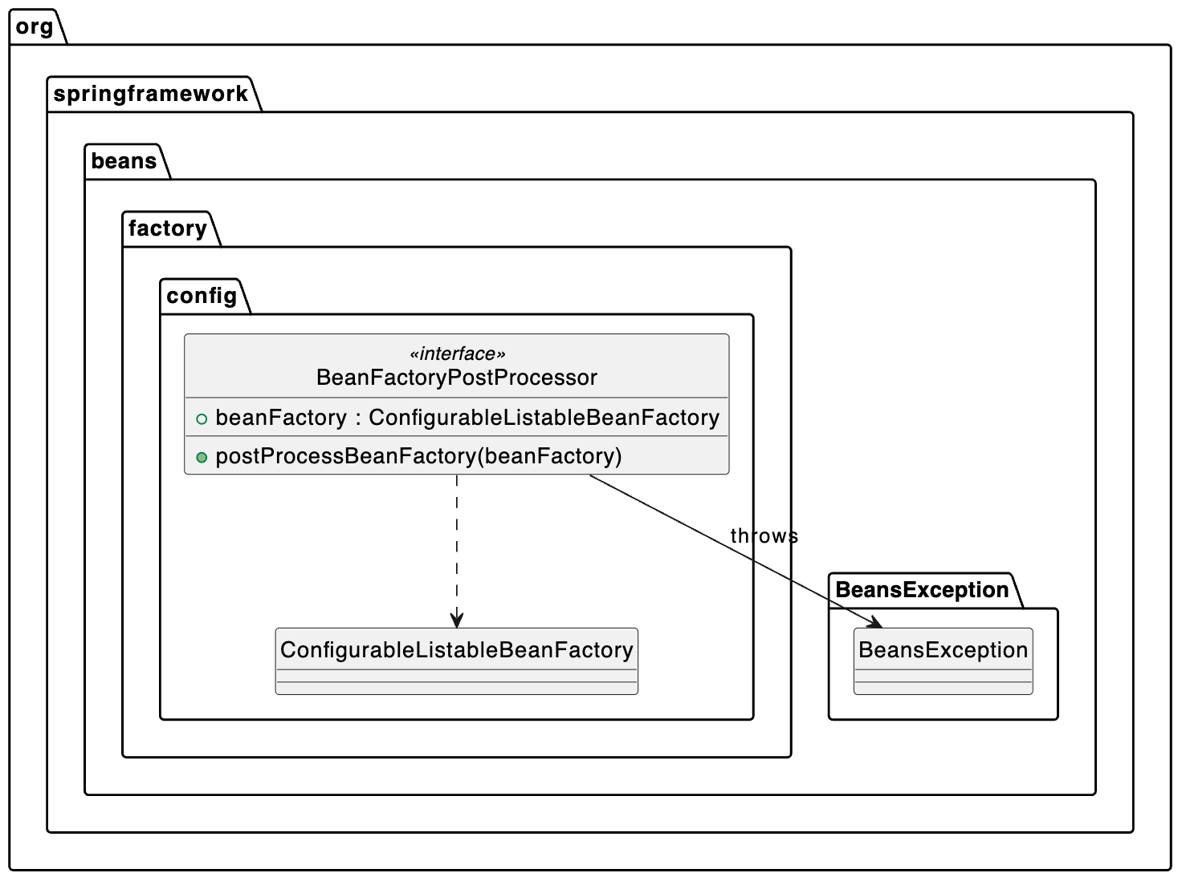
葉芯蘊：Config (BeanFactoryPostProcessor)

Slide 40
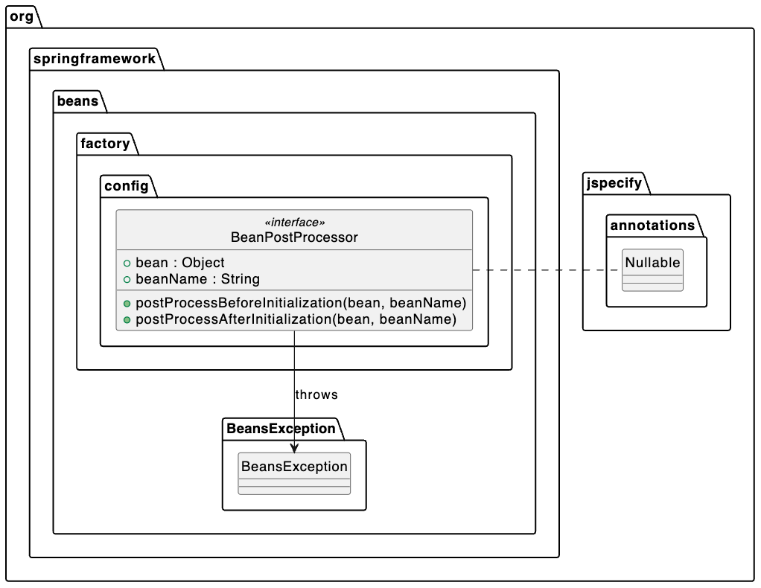
葉芯蘊：Config (BeanPostProcessor)

Slide 41
李冠儀
MutablePropertyValues and related code
(本週466，累積：2782)

Slide 42
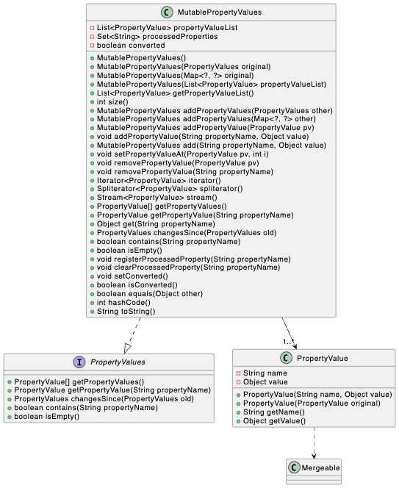
Prototype Pattern

Slide 43
Strategy Pattern

Slide 44
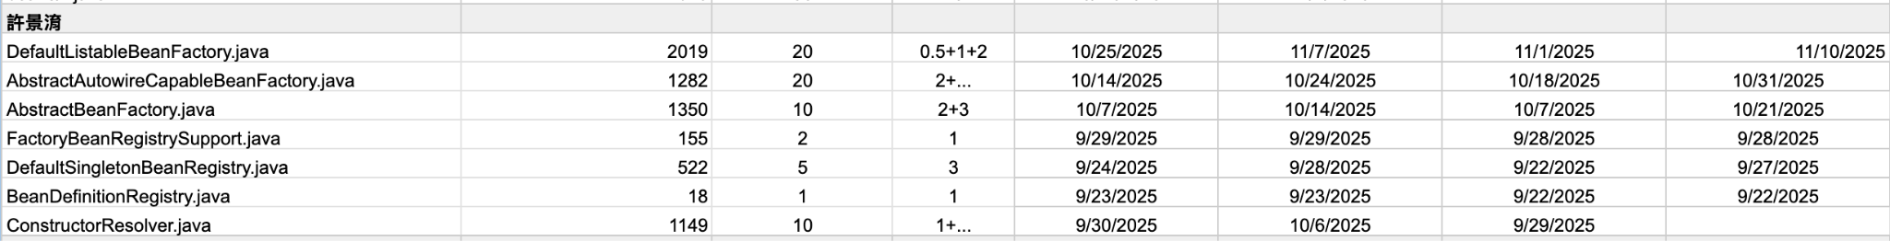
許景淯
本週：
DefaultListableBeanFactory (duration: 2+1, trace code: 1 ~ 2759 行)
2019 LoC
累積：5346 LoC

Slide 45

許景淯
Class Diagram:

Slide 46

許景淯
Class Diagram related with DefaultListableBeanFactory :

Slide 47
許景淯
AbstractAutowireCapableBeanFactory:
Strategy Pattern:
setAutowireCandidateResolver(AutowireCandidateResolver), delegate the judge to AutowireCandidateResolver to check whether the given bean definition qualifies as an autowire candidate for the given dependency.
setDependencyComparator(Comparator), delegate the comparing login to the Comparator / OrderComparator
Chain of Responsibility Pattern:
Delegates to the the parent DefaultListableBeanFactory when resolving bean

Slide 48

許景淯
Full diagram

Slide 49
陳垣豪
本周:
BeansDtdResolver.java, D*, N*, P*
閱讀行數: 768
Duration: 2+2
累計行數: 4596

Slide 50

陳垣豪
Strategy Pattern

Slide 51

陳垣豪
Strategy Pattern

Slide 52

陳垣豪

Slide 53
Thank you for your time

Slide 54
In Class WhiteBoard
Class
Class
Class

